Slide 1
Web Control
Lecture 4
Ⓒ 2018 ECSESS RoboElectronics Committee, Slides adapted from Dirk Dubois

Slide 2
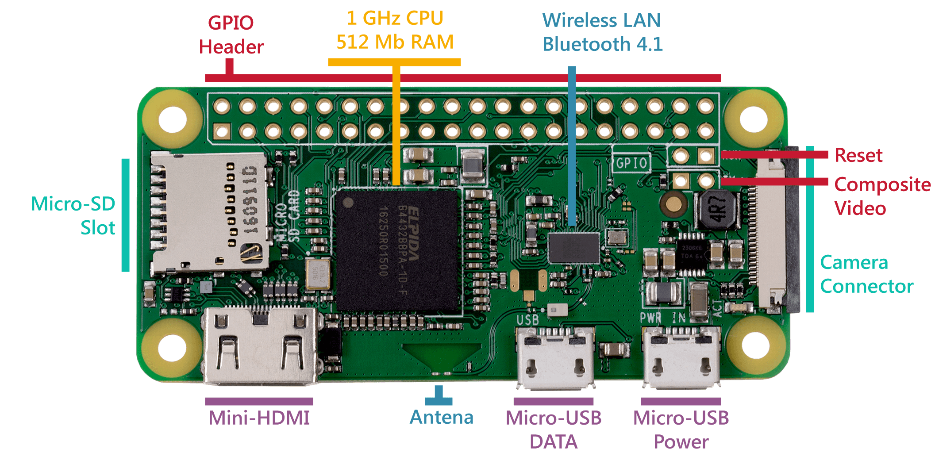
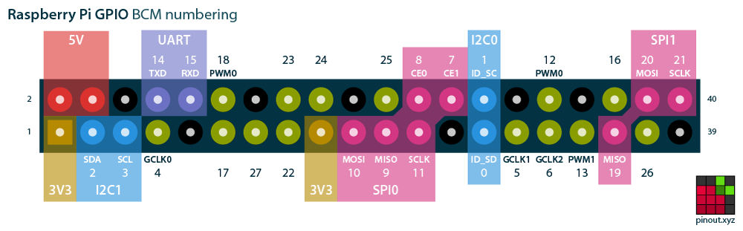
Raspberry Pi from last week
Learned about basics of Raspberry Pi
Ⓒ 2018 ECSESS RoboElectronics Committee, Slides adapted from Dirk Dubois
‹#›

Slide 3
Today’s Tasks
Be able to control the robot with the button on the web interface by the end of the workshop
Get the motors working if you didn’t get it last time
Link to starter code : https://github.com/HanYangZhao/RoboElectronics

Slide 4
What is REST?
Representational State Transfer
An architectural style for providing standards between computer systems on the web
REST-compliant systems (a.k.a. RESTful systems) are stateless and separate the concerns of client and server
stateless: server and client are agnostic of each other

Slide 5
What is REST? (cont’d)
Pros | Cons
Based on existing systems, e.g. HTTP, SSL, TLS Language independent (as long as you can make web-based requests using HTTP) Pervasiveness; widely compatible (Apache CXF, Angular, Node.js) | Limited by HTTP’s limitations, e.g. has to be stateless Disagreement between developers of what is REST-based and what’s not

Slide 6
Communication: Making Requests
Client makes request to server to retrieve or modify data
A request generally consists of:
an HTTP method (defines what kind of operation to perform)
a header (allows client to pass information about the request) - client specifies what type of content it is able to receive from the server (“Accept field”)
a query msg
a path to a resource
an optional message body containing data

Slide 7
REST Architecture
REST Clients
REST Server
GET
POST
PUT
DELETE
Http Methods
Web browser
Python Web Server(flask)
Mobile App
Http/s
Http/s
NodeJs
CURL Request
Apache

Slide 8
HTTP Verb
GET
Retrieve or send data
GET requests can be cached
GET requests remain in the browser history
GET requests should never be used when dealing with sensitive data
GET requests have length restrictions
Uses a query string
Data is visible to everyone in the URL
test.com/test/demo_form.php?name1=value1&name2=value2

Slide 9
HTTP Verb
POST
Retrieve or send data
POST requests are never cached
POST requests do not remain in the browser history
POST requests cannot be bookmarked
POST requests have no restrictions on data length
Data not displayed in the URL
Uses a body to store data
test.com/test/demo_form.php
Body : name1=value1&name2=value2

Slide 10
Response from server
Server sends data payloads to client
Response codes:
Code Range | Description
20x | All good
30x | Ask that dude over there
40x | You screwed up
50x | I screwed up

Slide 11
Controlling with Web: Flask
Used for communication between your robot and the web
Code on GitHub
Need to download 2 new libraries in Pi
sudo pip install flask-restful gpiozero
sudo apt-get update
sudo apt-get install pigpio python-pigpio python3-pigpio
Run sudo pigpiod
Run sudo pigpiod after each reboot

Slide 12
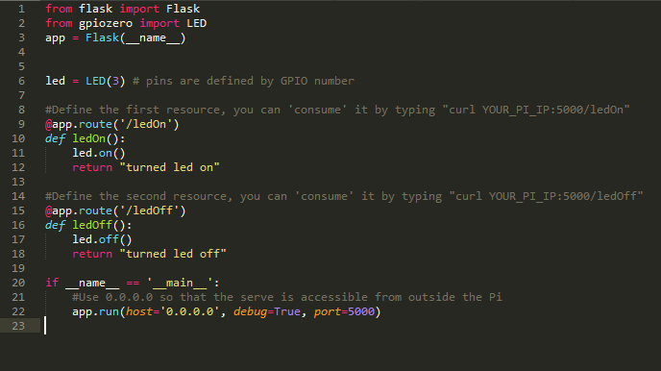
Controlling LED
By default, these resources are GET resources

Slide 13

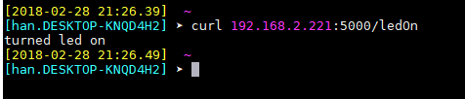
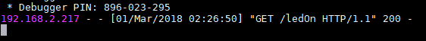
Controlling LED
Pi
Computer
Curl is a terminal based REST client, can make any kind of REST request.
Available by default on Linux/Mac
On windows, use Moba to create a new shell session( Session -> Shell)
Pi

Slide 14
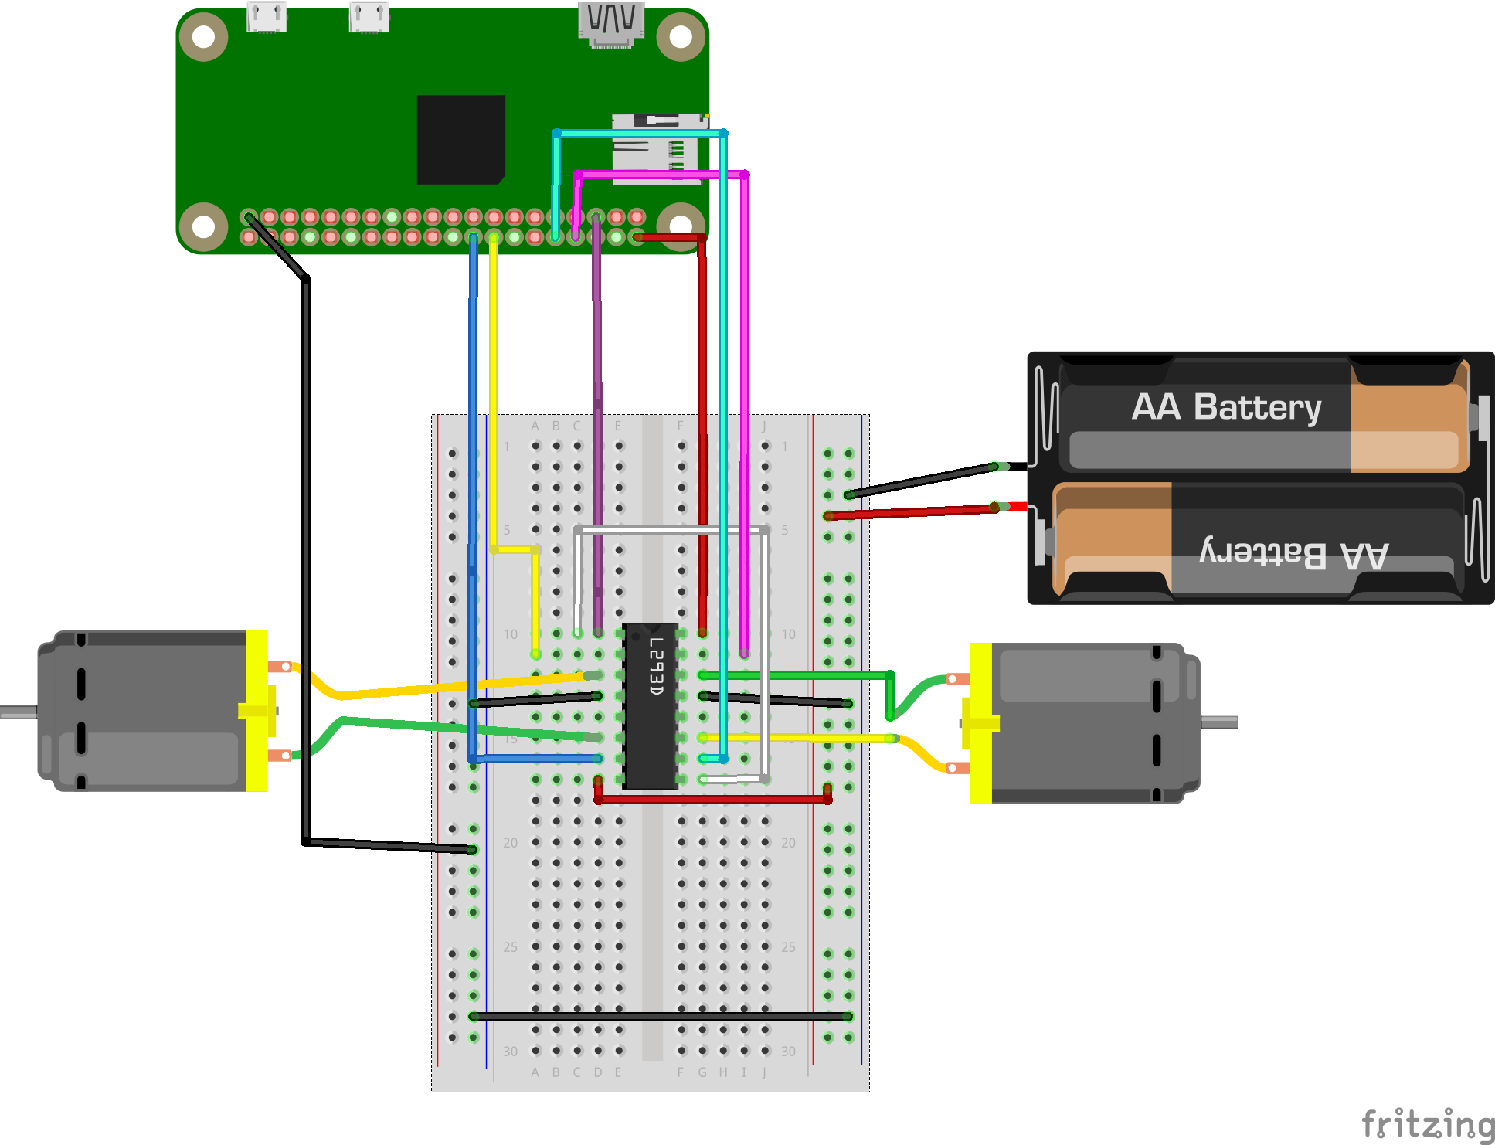
Controlling Motors

Slide 15
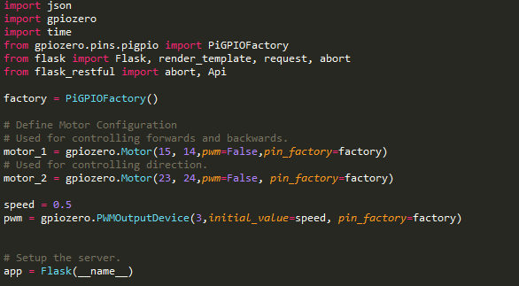
Controlling Motors
JSON stands for js object notation, which specifies the format of the data(command) we’re sending to the pi
{ "name":"value" }
PiGPIOFactory is another GPIO library we’re using
Here we disable the PWM on the motors pins and instead uses PWM on GPIO 3 which is connected to both enable pins on the H-bridge

Slide 16
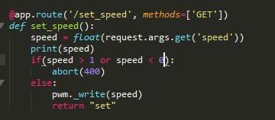
Controlling Motors
Resource to set the speed
Get request with query string
Take a float between 0,1
curl YOUR_PI_IP:5000/set_speed?speed=0.3

Slide 17
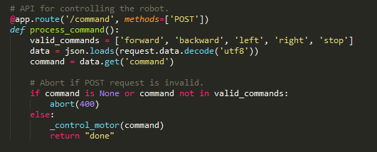
Controlling Motors
POST request which accepts json value
Accepts : forward,backward,left,right,stop in the request
Once the command is extracted, run the function “_control_motor”, otherwise return error code 400

Slide 18
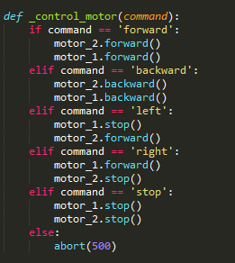
Controlling Motors

Slide 19
Controlling Motors
curl -H "Content-Type: application/json" -X POST -d '{"command":"stop"}' http://YOUR_PI_IP:5000/command
Specify that we’re sending JSON data in the header
Specify that we’re sending a POST request
Body

Slide 20

Controlling Motors
Renders the web page where you can control the motors with buttons
http://YOU_PI_IP:5000
Will be explained in detail next week and how to modify the webpage

Slide 21
Today’s Tasks
Be able to control the robot with the button on the web interface by the end of the workshop
Get the motors working if you didn’t get it last time
Link to starter code : https://github.com/HanYangZhao/RoboElectronics

Slide 22
Next week
Webpage Frontend (HTML/JS)
Servo to control the shooting motion

